Slide 1
The Abstract Data Type Queue
A queue is a list from which items are deleted from one end (front) and into which items are inserted at the other end (rear, or back)
  It is like line of people waiting to purchase tickets:
Queue is referred to as a first-in-first-out (FIFO) data structure.
  The first item inserted into a queue is the first item to leave
Queues have many applications in computer systems:
  Any application where a group of items is waiting to use a shared resource will use a queue. e.g.
    jobs in a single processor computer
    print spooling
    information packets in computer networks.
1

Slide 2

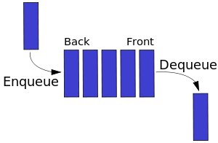
A Queue

Slide 3
A Queue
dequeue
enqueue
front
rear

Slide 4
ADT Queue Operations
createQueue()
  Create an empty queue
destroyQueue()
  Destroy a queue
isEmpty():boolean
  Determine whether a queue is empty
enqueue(in newItem:QueueItemType) throw QueueException
  Inserts a new item at the end of the queue (at the rear of the queue)
dequeue() throw QueueException
dequeue(out queueFront:QueueItemType) throw QueueException
  Removes (and returns) the element at the front of the queue
  Remove the item that was added earliest
getFront(out queueFront:QueueItemType) throw QueueException
  Retrieve the item that was added earliest (without removing)

Slide 5
Some Queue Operations
Operation Queue after operation
x.createQueue() an empty queue
front
↓
x.enqueue(5) 5
x.enqueue(3) 5 3
x.enqueue(2) 5 3 2
x.dequeue() 3 2
x.enqueue(7) 3 2 7
x.dequeue(a) 2 7 (a is 3)
x.getFront(b) 2 7 (b is 2)

Slide 6
Implementations of the ADT Queue
Pointer-based implementations of queue
  A linear linked list with two external references
    A reference to the front
    A reference to the back
  A circular linked list with one external reference
    A reference to the back
Array-based implementations of queue
  A naive array-based implementation of queue
  A circular array-based implementation of queue

Slide 7
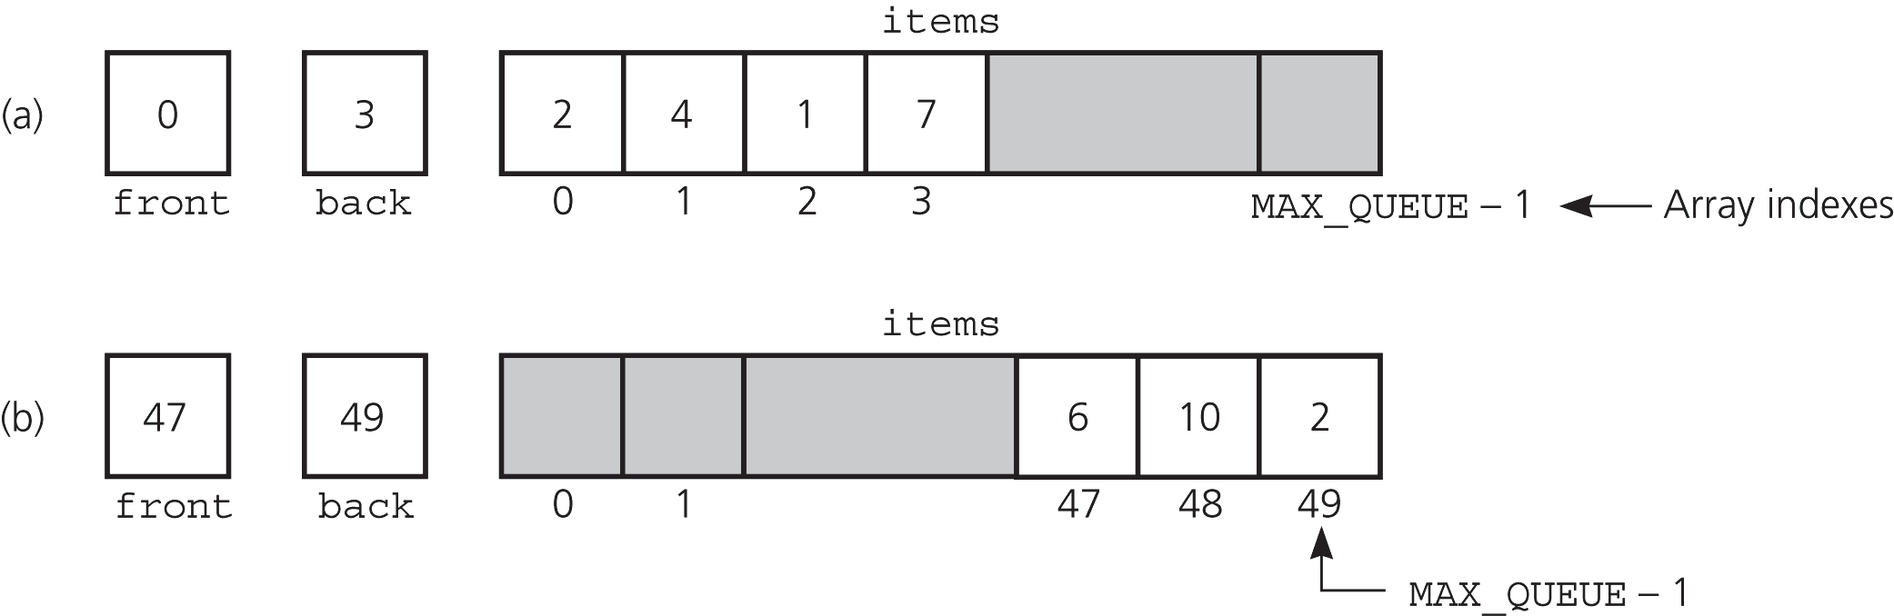
A Naive Array-Based Implementation of Queue
Rightward drift can cause the queue to appear full even
though the queue contains few entries.
We may shift the elements to left in order to compensate
for rightward drift, but shifting is expensive
Solution: A circular array eliminates rightward drift.

Slide 8
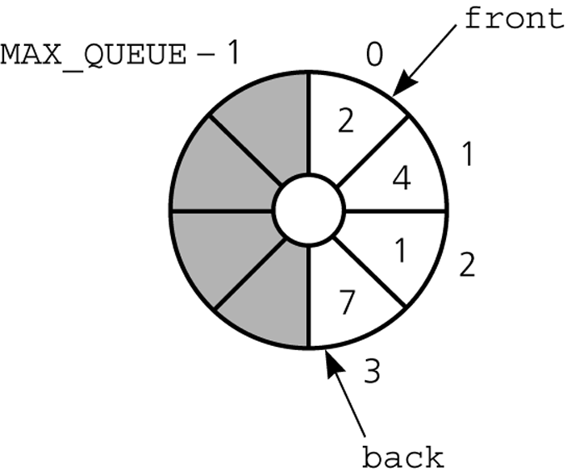
A Circular Array-Based Implementation
When either front or back
advances past MAX_QUEUE-1
it wraps around to 0.

Slide 9
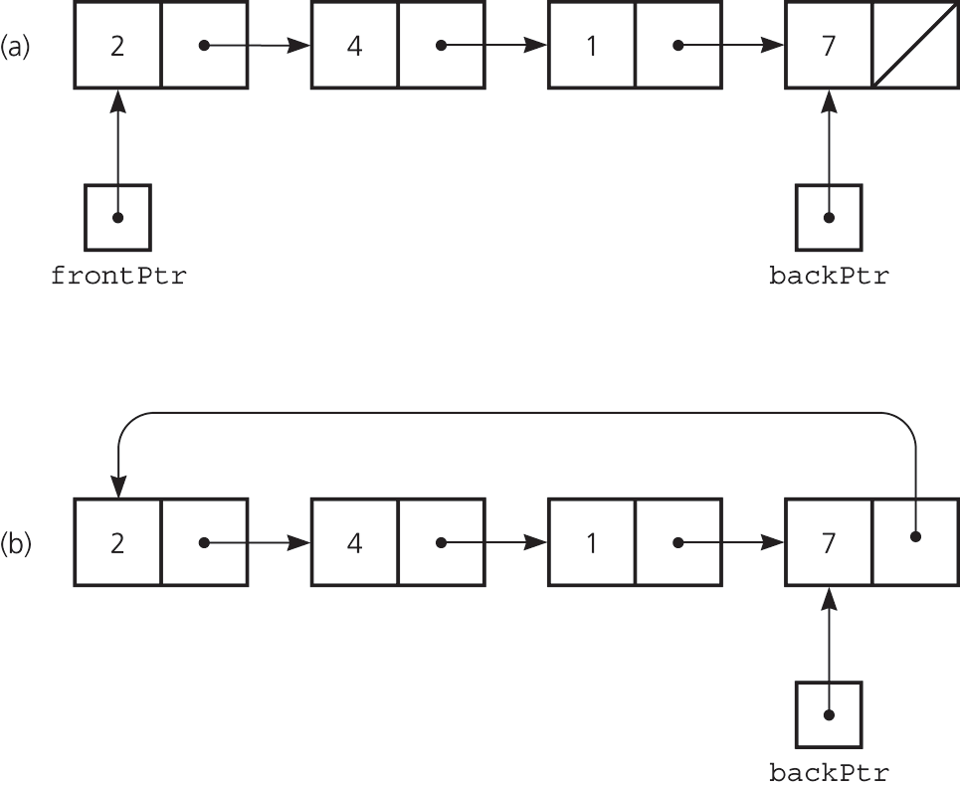
Pointer-based implementations of queue
a linear linked list with two external pointers
a circular linear linked list with one external pointer

Slide 10
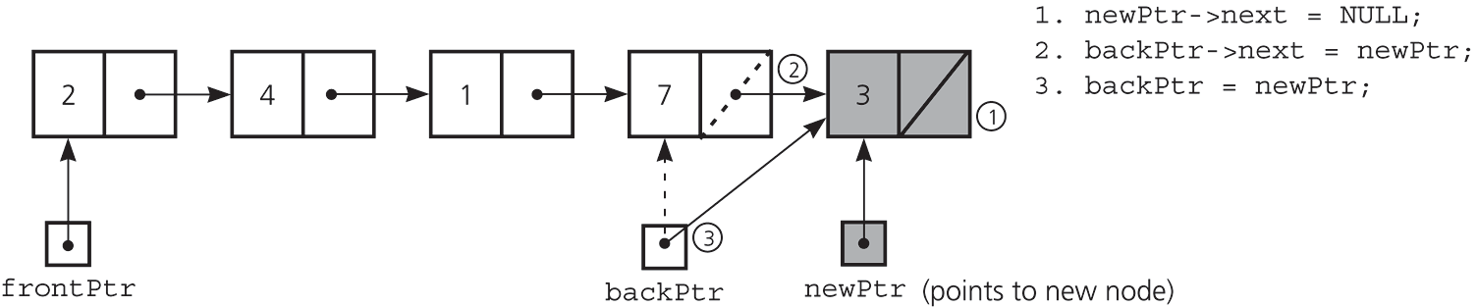
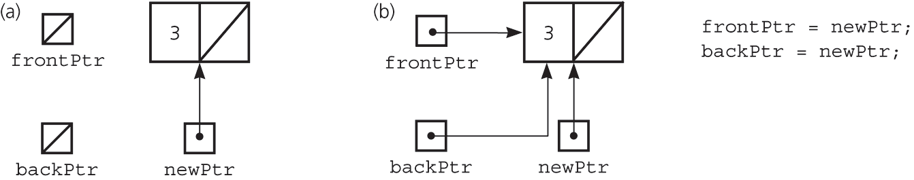
A linked list Implementation -- enqueue
Inserting an item into a nonempty queue
Inserting an item into an empty queue
a) before insertion
b) after insertion

Slide 11
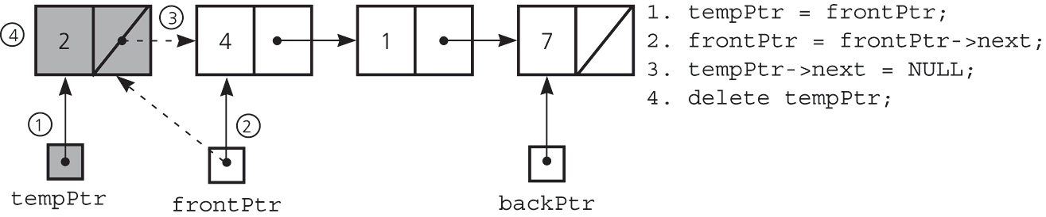
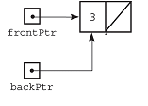
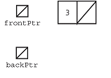
A Linked list Implementation -- dequeue
Deleting an item from a queue of more than one item
Deleting an item from a queue with one item
tempPtr = frontPtr;
frontPtr = NULL;
backPtr = NULL;
delete tempPtr;
tempPtr
before deletion
after deletion

Slide 12
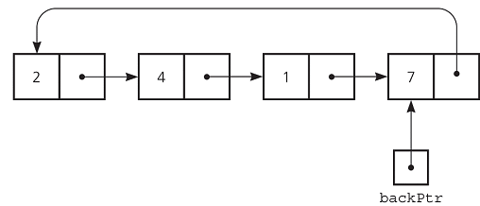
A circular linked list with one external pointer
Queue Operations
constructor ?
isEmpty ?
enqueue ?
dequeue ?
getFront ?

Slide 13
Comparing Implementations
Fixed size versus dynamic size
  A statically allocated array
    Prevents the enqueue operation from adding an item to the queue if the array is full
  A resizable array or a reference-based implementation
    Does not impose this restriction on the enqueue operation
Pointer-based implementations
  A linked list implementation
    More efficient; no size limit
  The ADT list implementation
    Simpler to write; inefficient

